Slide 1
Build & Modernize AI Applications
Vector Search & AI Assistant Hackathon
Challenge 1: Deployment and local setup
https://github.com/Azure/Build-Modern-AI-Apps-Hackathon
Notes:
Hello. Today I’m going to walk you through the Build and Modernize AI Applications Hackathon for the Vector Search & AI Assistant solution accelerator we created as part of the Build & Modernize AI Applications solutions for Microsoft.
The hackathon is comprised of a series of 5 required challenges with challenges 6 and 7 optional for attendees to do if they complete the other five challenges.
This is the train the trainer video for Challenge 1: deployment and local setup.
In this video, I’m going to walk you through how to deploy the services for this hackathon and get the solution configured to run and debug on your locale machine. Throughout the video I will highlight key pieces of knowledge to help you as you coach users through this challenge in the hackathon.
This video is part of a series of train the trainer videos, power points and other assets provided as part of the training materials for delivering this hackathon.
The user assets for this hackathon with each of the seven challenges, plus the starter solution and deployment script and templates are available at github.com/azure/build-modern-ai-apps-hackathon.

Slide 2
Scenario
The scenario centers around a consumer retail "Intelligent Agent" that allows users to ask questions on vectorized product, customer and sales order data stored in a database. The data in this solution is the Cosmic Works sample for Azure Cosmos DB. This data is an adapted subset of the Adventure Works 2017 dataset for a retail Bike Shop that sells bicycles, biking accessories, components and clothing.
BUT you can bring your own data instead.
Notes:
The scenario our solution presents is one of a retailer that sells bikes and accessories. The data for this is adapted from the classic SQL Server, Adventure Works 2017 dataset.
We used this dataset because it is simple to use and allows us to explain the key concepts for building this type of solution so users can do this for themselves, using their own data.

Slide 3
Prerequisites
Azure Subscription
Visual Studio
.NET 7
Docker Desktop (ensure its running)
Azure CLI 2.49.*
Azure Open AI access
(120K tokens for GPT 3.5 & ADA-002)
Subscription owner permissions
(or Resource Group owner if using an existing resource group)
Notes:
Before you or an attendee gets started with this hackathon the following prerequisites are required. This includes:
Note: this hackathon assumes the attendee not only has the prerequisites required to participate in this hackathon but experience and is comfortable using these or otherwise is familiar writing code and developing applications.

Slide 4
Git Clone to start
git clone https://github.com/Azure/Build-Modern-AI-Apps-Hackathon
cd .\Build-Modern-AI-Apps-Hackathon\
git checkout main
code readme.md
cd .\starter-artifacts\code\VectorSearchAiAssistant
Notes:
To get started, users should open a new terminal and clone the hackathon repo onto their local machine.
From there they can navigate into the new git project then checkout the main branch.
Next users should open the readme file and follow the instructions for how to deploy and get the solution up and running locally.
Before starting the deployment, users will then want to navigate into the starter solution to set them up for the next step.

Slide 5
Sample PowerShell install command
./scripts/Starter-Deploy.ps1 `
-resourceGroup <resource group> `
-location <region> `
-subscription <subscription id> `
-openAiName <open ai account> `
-openAiRg <open ai resource group> `
-openAiCompletionsDeployment <completions> `
-openAiEmbeddingsDeployment <embeddings>
Notes:
Once users have navigated to the solution directory, then can then execute the Starter Deploy PowerShell script as shown here.
By default, the script will create a new Azure OpenAI account and deploy two foundational models, GPT 3.5 Turbo for completions and TEXT-ADA-002 for embeddings.
<Click> If your organization has already deployed an Azure OpenAI account along with the GPT 3.5 Turbo and ADA models, they can specify their existing account name and names for the deployed models.
In this example I’m providing an existing OpenAI account name and resource group where the account has been deployed. The names for the existing deployed models should match exactly what has been deployed in your Azure Open AI account.
The script will deploy the web application and service layer containers into Azure Container Apps. There is an option to deploy these into AKS but for the hackathon we recommend using ACA.
Note that if the resource group does not yet exist the script will initially report an error. Users can simply ignore this as the script will create the resource group in the subscription.

Slide 6
Deployable regions (October 2023)
 | Cosmos DB | Cog Search | OpenAI | ACA | ACR | Storage
Australia East | X | X | X | X | X | X
Canada East | X | X | X | X | X | X
US East | X | X | X | X | X | X
US East 2 | X | X | X | X | X | X
France Central | X | X | X | X | X | X
Japan East | X | X | X | X | X | X
North Central US | X | X | X | X | X | X
Switzerland North | X | X | X | X | X | X
UK South | X | X | X | X | X | X
Sweden Central | X | X | X | X | X | X
South Central US | X | X | X | X | X | X
West Europe | X | X | X | X | X | X
Notes:
Here are the list of Azure regions in which all of the services for this solution and hackathon can be deployed in. This solution has been deployed and tested in each region listed.
Hackathon attendees may have restrictions in specific regions depending on their subscription type. Particularly subscriptions with benefit offer types or Azure Pass. If customers have concerns or have experienced issues deploying new workloads into specific regions, be sure to guide them towards the hub regions highlighted in green here.

Slide 7
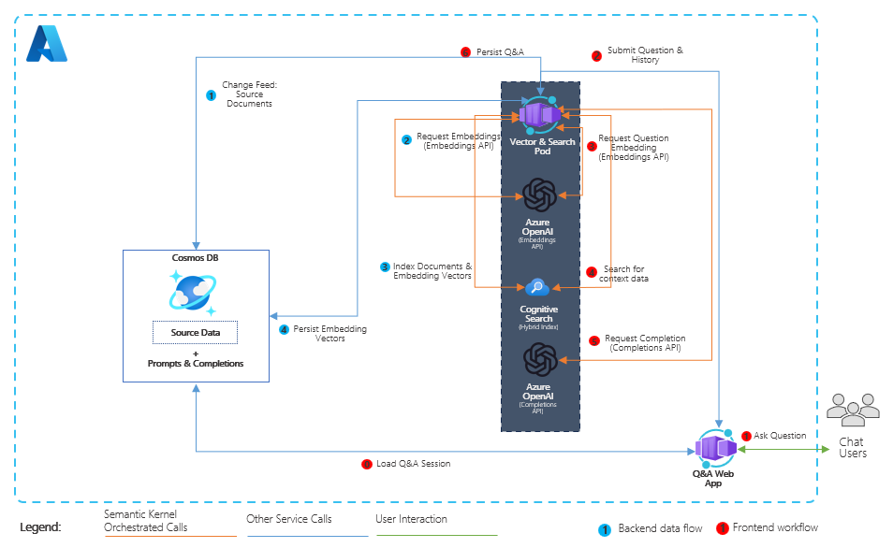
Reference Architecture
Notes:
Let’s take a look at the architecture diagram for what gets deployed in our solution.
On the left-hand side is our database, Azure Cosmos DB for NoSQL. This stores all the transactional data for our retail bike shop including the product catalog, customer profiles and their sales orders. It also stores the user prompts (or questions from users) AND the completions (or responses from OpenAI).
Other services deployed include Azure Cognitive Search which includes the vectored data. Also here is Azure OpenAI service with the deployed completions and embeddings models.
Both the service layer and web front-end are containerized and deployed into Azure Container Apps.
The last service which isn’t shown here is Azure Storage, which stores system prompts, various store policies and other content which is used in the solution.

Slide 8
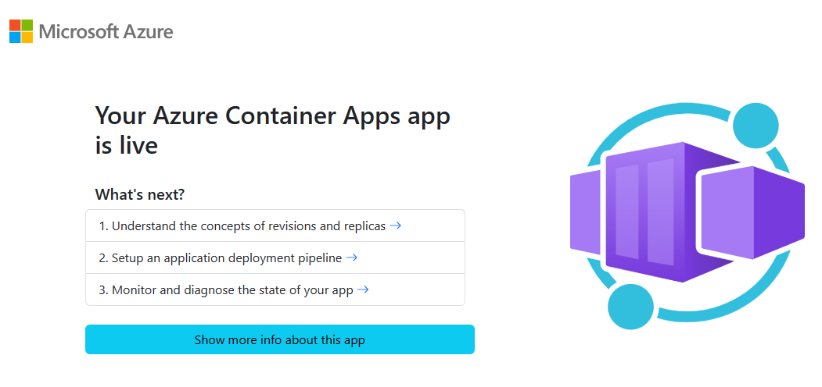
Validating the deployment
az deployment group show
-g <resource-group-name>
-n cosmosdb-openai-azuredeploy
-o json
--query properties.outputs.webFqdn.value
Notes:
After the deployment completes users will see an output in the script window that includes a URL to the web application which they can click to open the deployed solution.
You can also validate the deployment by running this azure cli command in cloud shell or any shell which is authenticated into Azure.
The output from this script will be the fully qualified domain name to the web application for this solution.
It is important to note to your users that opening the URL will not show the application itself. There are additional challenges to complete before users will see the final application.
<click> What users will see is the placeholder for Azure Container Apps in their browser. If users see this page then the deployment was successful and they can move on to the next challenge.

Slide 9
What gets deployed
Notes:
Unlike the solution accelerator installation which will load and vectorize the sample data for this solution, this setup will just deploy the services. Users will go through the process of loading and vectorizing the data in a later challenges.
Let’s go into the Azure portal and explore the services.
[Return to browser to Azure portal tabs]
Show each of the services within the portal.
OpenAI – click on Models, click on completions show GPT 35, click on embeddings, show ada-002.
Cosmos DB – show the containers with the data, call out the embeddings container which gets indexed by Cog Search. Click and show completions container.
Cog Search – show that during the hackathon they will create a new index and add data from Cosmos and its vectors into it.
Storage – click containers, show return policy, go into system prompts, show that as well.
Container registry – simply mention it.
ACA - show one for API and one for Web, click into web api, click containers, show environment variables.

Slide 10
Configure for local execution and debugging
Notes:
The last step in this challenge is to get the local debug environment setup.

Slide 11
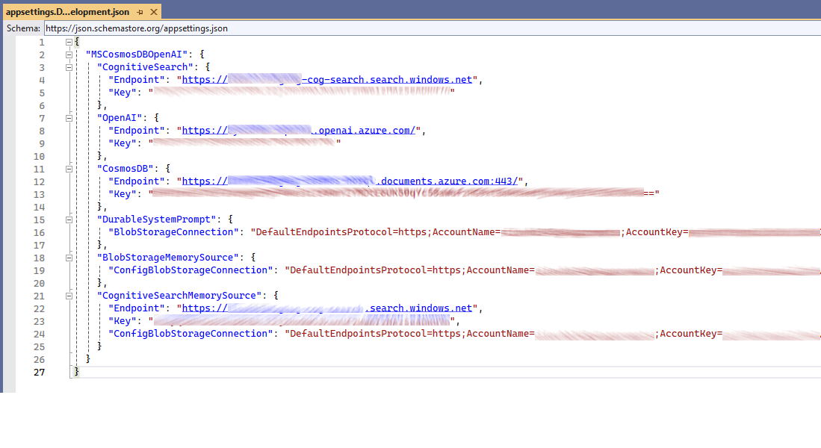
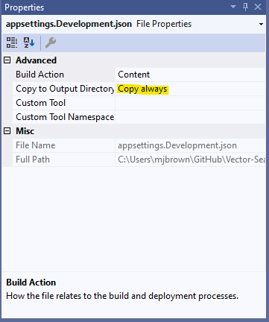
appsettings.Development.json
Notes:
Once the user has Visual Studio open they will need to create a new appsettings.Development.json file.
Be sure the file has a Capital D in Development in the name.
The values for each of these can be found in the environment variables in the Azure Container App instance that hosts the Web API project. Users can also go into each of the services and copy these values.
<click> Once the values are saved, be sure the user changes the file property for Copy to Output Directory to “Copy Always” so the file gets deployed into the output directory when the project is started.

Slide 12
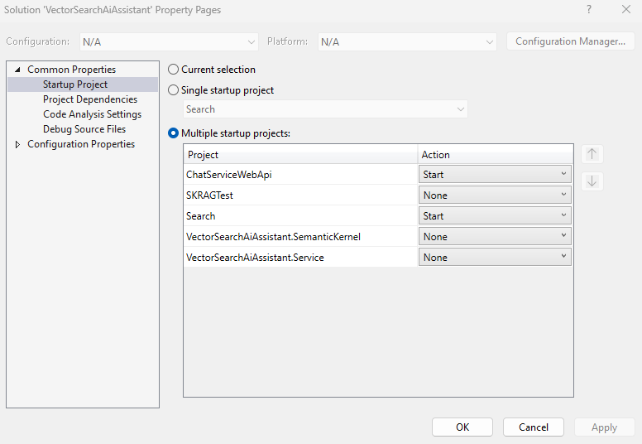
Startup Projects
Notes:
The last step in this challenges is to configure the startup projects in Visual Studio. To do this right click the solution and , select “Configure Startup Projects” then ensure that both the ChatServiceWebApi and Search projects are set to start.

Slide 13
Thank you!
Notes:
That’s it. Users should now be able to F5 and run the solution locally on their machine so they can complete the other challenges for this hackathon.
Thank you for watching and enjoy your hackathon delivery!!!

